Slide 1
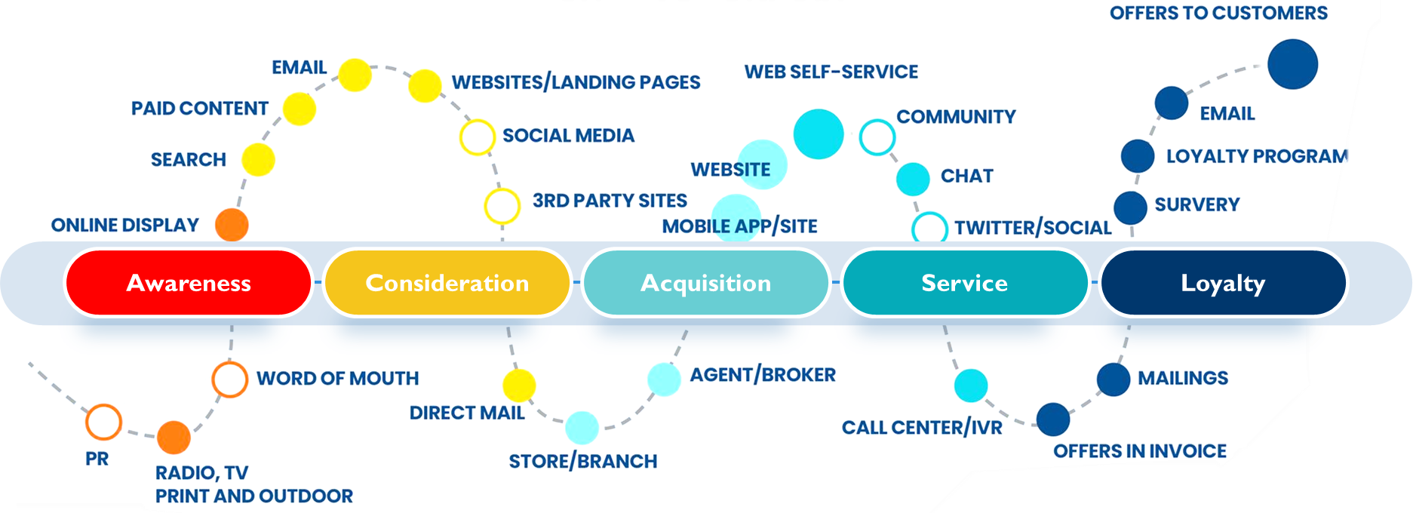
BUYER’S JOURNEY: STANDARD JOURNEY & CHANNELS
Identify the channels that your research so far indicates will be the most impactful to your personas at each phase
DIGITAL TOUCHPOINTS
PHYSICAL TOUCHPOINTS

Slide 2
YOUR BUYER’S JOURNEY
Buyer’s journeys follow the same basic structure, but channels and messaging may vary by persona
Customer is researching and /or trialing your solution
MESSAGE ON WHAT YOU SOLVE & HOW
Customer is discovering your product’s broader value and uses
FOCUS ON SUPPORT AND EDUCATION
Awareness
Consideration
Acquisition
Service
Loyalty
Customer is just becoming aware that you exist
MESSAGE ON WHY THEY SHOULD CARE
Customer is getting ready to or has just purchased your solution
MESSAGE ON SUCCESS STORIES & EASY BUY
Customer becomes a brand advocate (word-of-mouth)

Slide 3
BUYER’S JOURNEY WORKSHEET
PHASE | KEY MESSAGES YOU WANT TO COMMUNICATE | CHANNELS
AWARENESS | Why should the customer care about your services?
CONSIDERATION | What problem are you trying to solve and how do you solve it?
ACQUISITION | What successes have you had? How does one buy from you?
SERVICE / MAINTENANCE | What ongoing services, support and education do you provide?
LOYALTY | What recognition and reward can you offer for customer word-of-mouth advertising and advocacy?
Top Line Messaging By Buying Phase

