Slide 1
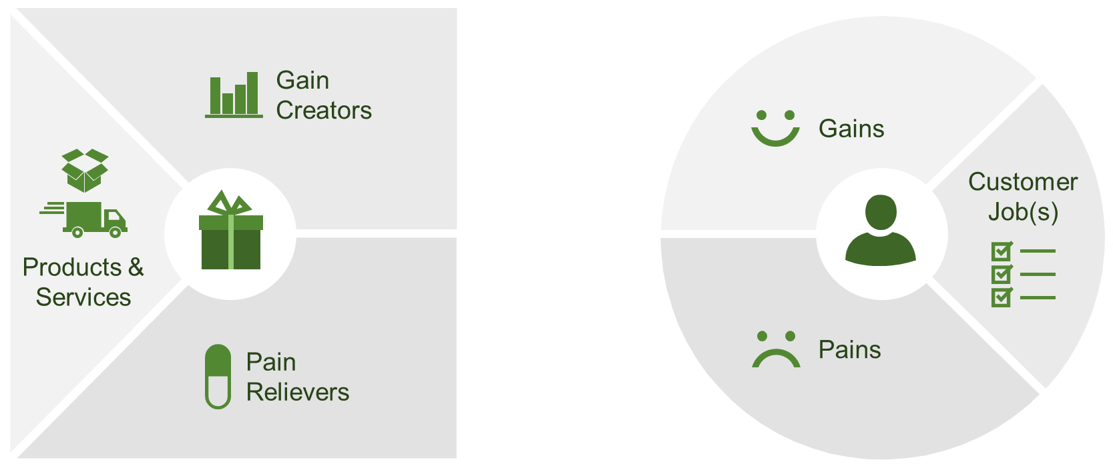
Value Proposition Canvas
VALUE PROPOSITION CANVAS
Your product or service
Your customer’s experience

Slide 2
VALUE PROPOSITION CANVAS: PRODUCT FEATURES
Your product or service
PRODUCTS AND SERVICES | List your products, services and features
PAIN RELIEVERS | Describe the elements of your product that remove a current frustration your customer has
GAIN CREATORS | Describe the elements of your product that produce a new positive experience or improve the user’s current experience

Slide 3
VALUE PROPOSITION CANVAS: PRODUCT FEATURES
Your product or service
CUSTOMER JOB(S) | List what your customer has to do or the process they must follow to use your product effectively
GAINS | What are the things they will gain as a result of accessing the benefits your product offers
PAINS | What are the pains they can avoid as a result of accessing the benefits your product offers

