Slide 1
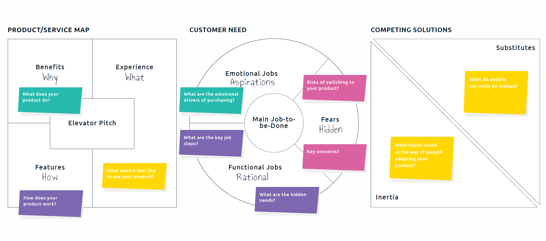
POSITIONING YOUR PRODUCT OR SERVICE

Slide 2
POSITIONING STATEMENT
FOR | Target market / persona
WHO | Describe unmet need (can pull from your persona)
OUR PRODUCT | Describe what your product or service is (what does it do, what is the benefit)
BY / WITH | Describe how your product works (what features make it possible to do what it does)
SO THAT | Key benefits and customer experience
Positioning Statement

Slide 3
ELEVATOR PITCH: ADDING COMPETITIVE CONTEXT
FOR | Target market / persona
WHO | Describe unmet need (can pull from your persona)
OUR PRODUCT | Describe what your product or service is (what does it do, what is the benefit)
BY / WITH | Describe how your product works (what features make it possible to do what it does)
SO THAT | Key benefits and customer experience
BETTER THAN | Competitors
BECAUSE | Key differentiator
Positioning Statement
Elevator Pitch

Slide 4
CUSTOMER NEED: ADDING CUSTOMER CONTEXT
MAIN JOB-TO-BE-DONE | Positioning Statement and Elevator pitch
ASPIRATIONS | What are the emotional drivers to purchase your product?
RATIONAL | What are the rational drivers to purchase your product? (try to include obvious and hidden drivers)
FEARS | What concerns might prevent a customer from purchasing your product? (try to include fears of switching from what they are already doing to address their needs)

